Slide 1
DSC530 Term Project:Analyzing the Impact of Temperature on Electric Vehicle Charging Rates
Presentation By: Rohit Karanjit
Student ID: 21448718
Bellevue University
Professor Matthew Metzger
Date: 16th November 2024

Slide 2
Introduction
As EV adoption increases, understanding factors that impact charging efficiency is crucial for optimizing charging infrastructure and battery technology.

Slide 3
Objective
Investigate how temperature influences the charging rate in electric vehicles (EVs).
Determine whether lower temperatures affect charging efficiency and speed.

Slide 4
In this analysis, the central question was:
Does ambient temperature significantly affect the charging duration and efficiency (charging rate) of electrical question (EVs)?

Slide 5
The 5 Important Variables In The Dataset
Temperature (°C): The principal variable for the hypothesis as it affects charging efficiency.
Charging Rate (kW): Another important variable in the hypothesis, as temperature directly influences it.
Energy Consumed (kWh): Including this allows you to evaluate if temperature affects total energy use each session, which may suggest charging efficiency.
Charging Duration (hours): This will help you understand if temperature affects the rate and overall time required for a charge.
Battery Capacity (kWh): Battery capacity distinguishes smaller and bigger EVs, which may affect charging speeds and efficiency due to temperature. Built-in safety features may slow charging in high temperatures for bigger batteries, whereas smaller cells may be more susceptible to ambient conditions.

Slide 6
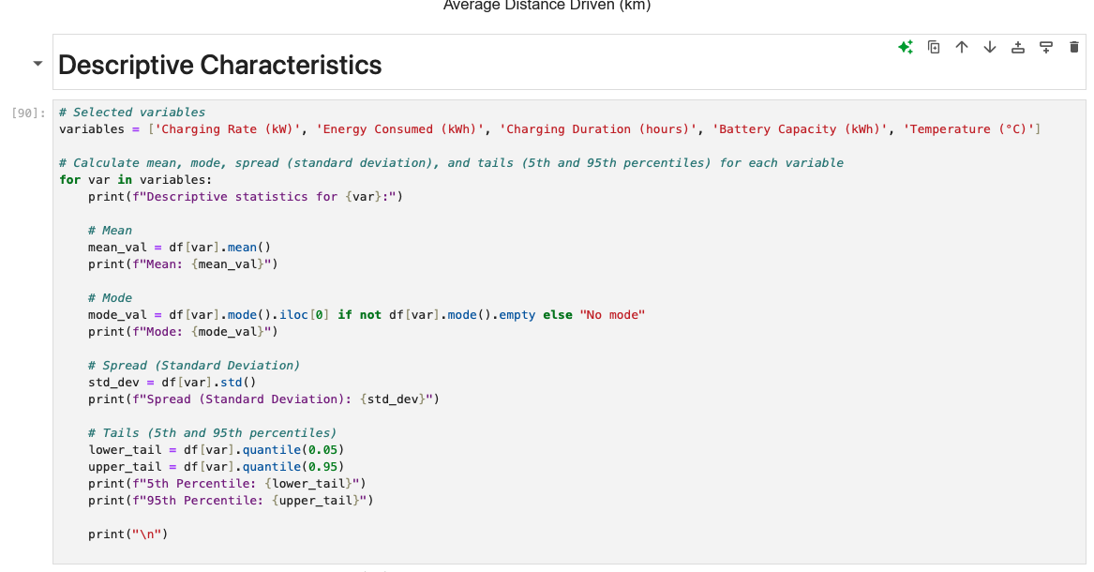
Descriptive Characteristics

Slide 7
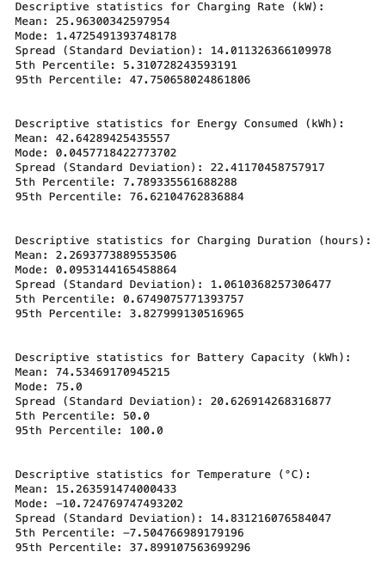
Output:

Slide 8
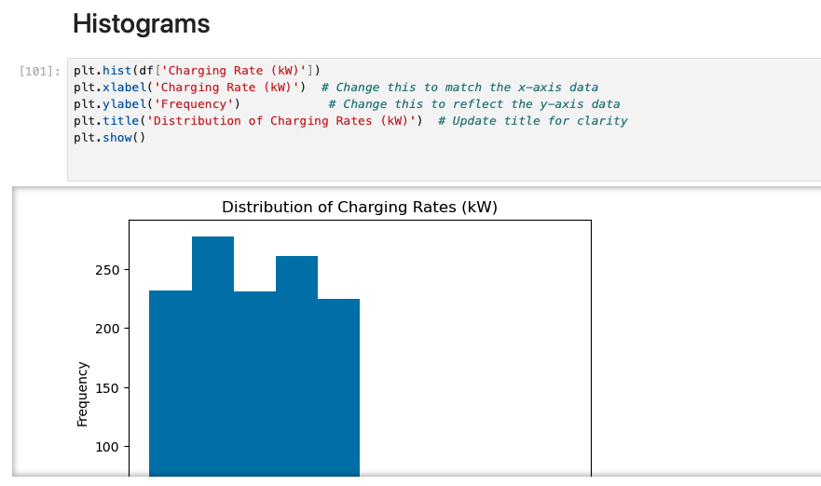
Histogram

Slide 9
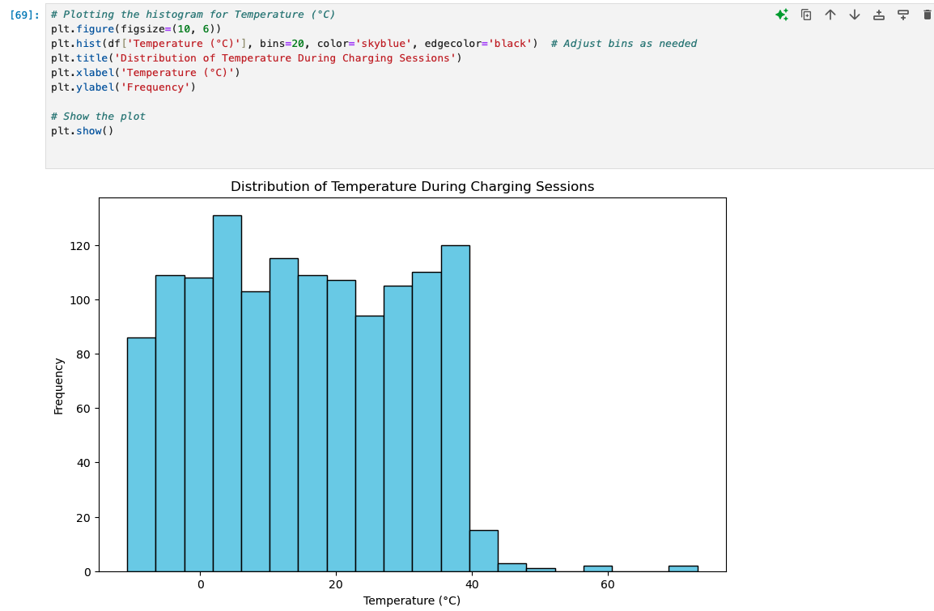
Histogram (contd.)

Slide 10
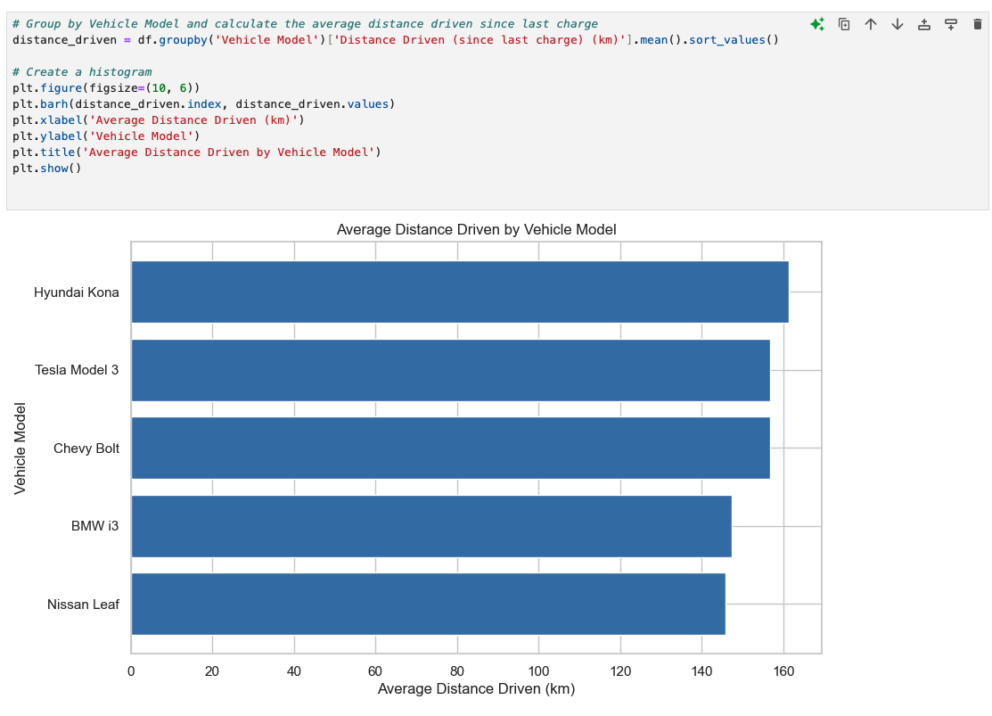
Histogram (contd.)

Slide 11
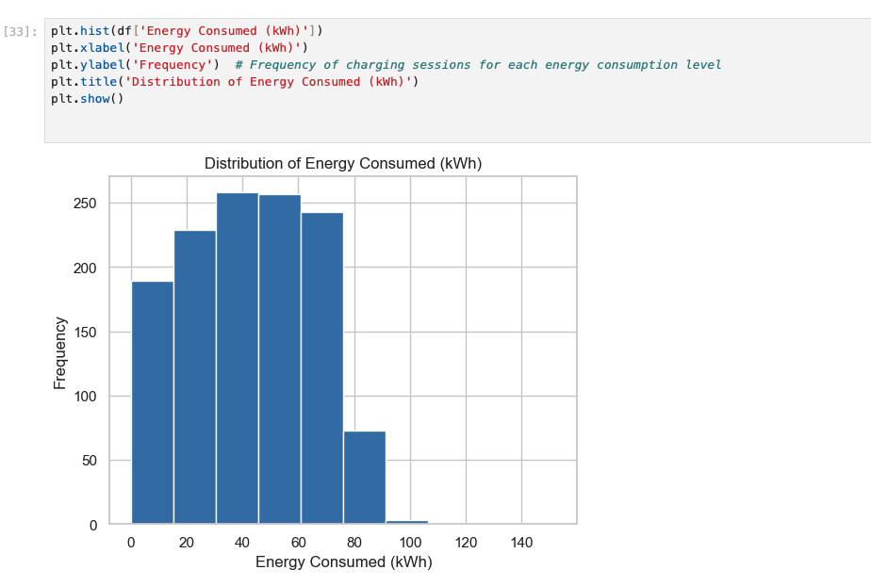
Histograms (contd.)

Slide 12
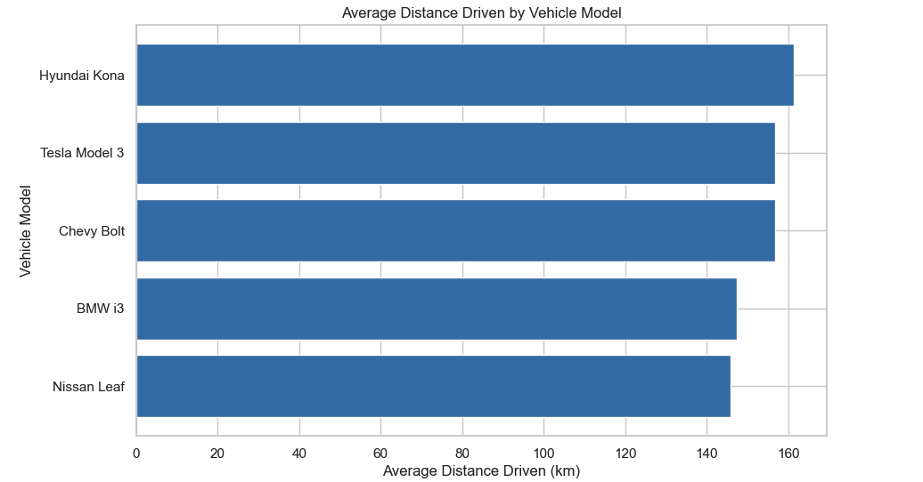
Histogram (contd.)

Slide 13
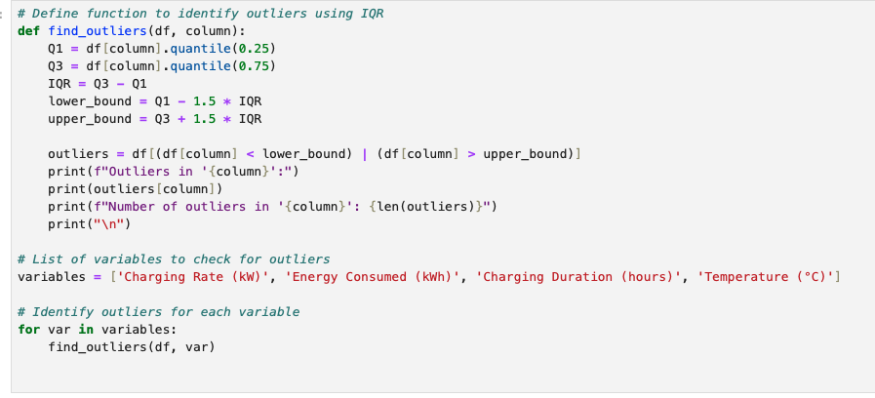
Identifying Outliers

Slide 14
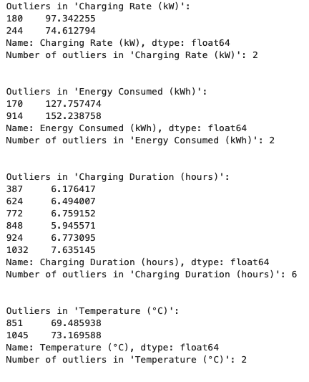
Output

Slide 15
Identifying Outliers
Outliers in 'Charging Rate (kW)' Outlier Values: 97.34 kW and 74.61 kW are identified as outliers in the "Charging Rate (kW)" column.
Number of Outliers: There are two outliers in this variable. Interpretation: These values are significantly higher than typical charging rates. Depending on the context, they may represent unusually fast charging sessions or errors in data entry.

Slide 16
Identifying Outliers (contd.)
Outliers in 'Energy Consumed (kWh)' Outlier Values 127.76 kWh and 152.24 kWh are identified as outliers in the "Energy Consumed (kWh)" column.
Number of Outliers: There are two outliers in this variable. Interpretation: These values represent unusually high energy consumption during a single charging session, potentially from long-distance trips or high-capacity batteries. Again, they may be valid but have extreme values or errors.

Slide 17
Identifying Outliers (contd.)
Outliers in 'Charging Duration (hours)' Outlier Values: 6.18 hours, 6.49 hours, 6.76 hours, 5.95 hours, 6.77 hours, and 7.64 hours are identified as outliers in the "Charging Duration (hours)" column.
Number of Outliers: There are 6 outliers in this variable. Interpretation: These values indicate particularly long charging sessions. This could happen if users left their EVs charging for extended periods or if they were using slow chargers. Depending on the typical charging duration, such sessions represent edge cases or errors.

Slide 18
Identifying Outliers (contd.)
Outliers in 'Temperature (°C)' Outlier Values: 69.49 °C and 73.17 °C are identified as outliers in the "Temperature (°C)" column.
Number of Outliers: There are two outliers in this variable. Interpretation: These extremely high temperature values may represent rare extreme weather conditions or potential sensor errors. In typical cases, such high temperatures during EV charging would be unusual.

Slide 19
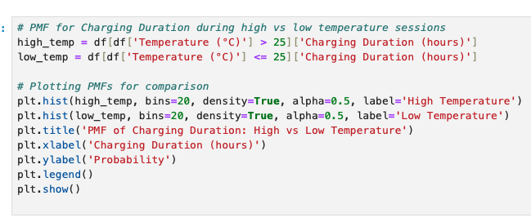
PMF Analysis of Charging Duration – High vs Low Temperature

Slide 20
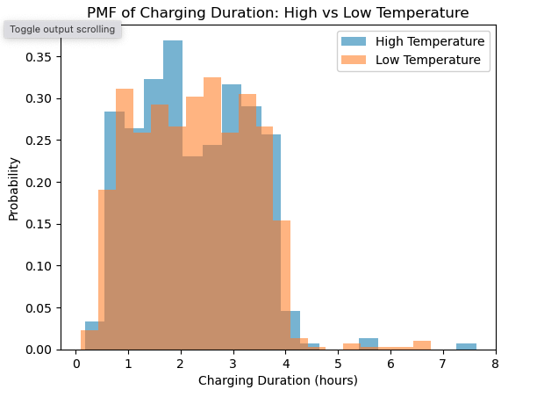
PMF Analysis of Charging Duration – High vs Low Temperature

Slide 21
PMF Analysis of Charging Duration – High vs Low Temperature (contd.)
Charging Durations for high and low temperatures largely overlap between 1 and 4 hours.
There is a slightly higher probability of charging durations around 1.5 to 2.5 hours, suggesting shorter sessions on average.
There is a rare instance of 5-7 hour sessions, more common at high temperatures.
Overall, temperature has a moderate impact on charging duration.
Warmer conditions may improve charging efficiency, but temperature is not the only influencing factor.

Slide 22
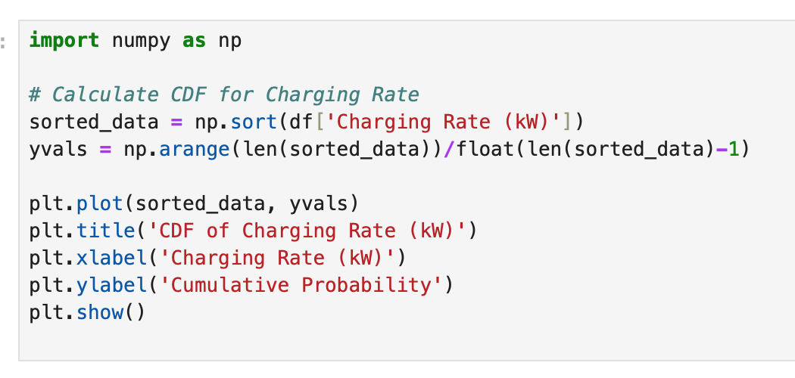
Plotting Cumulative Distribution Function (CDF)

Slide 23
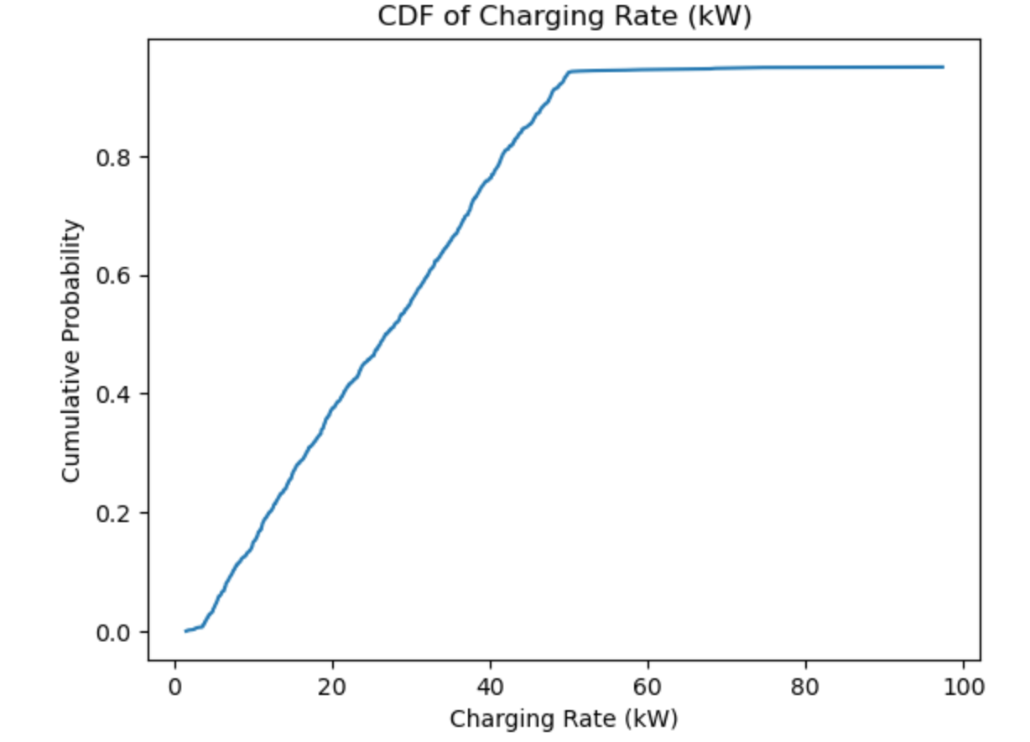
Plotting Cumulative Distribution Function (CDF) contd..

Slide 24
Key points for this CDF of Charging Rate (kW):
Even Distribution: Charging rates gradually increase up to around 60 kW, indicating an even spread across this range.
Range: Most charging rates fall between 0 and 60 kW.
Median: About 50% of sessions have a charging rate of 30 kW or less.
Plateau at 100 kW: The curve levels off near 100 kW, suggesting it’s the maximum rate in the dataset.
Implication: Moderate charging rates dominate, indicating fewer high-speed charging sessions.

Slide 25
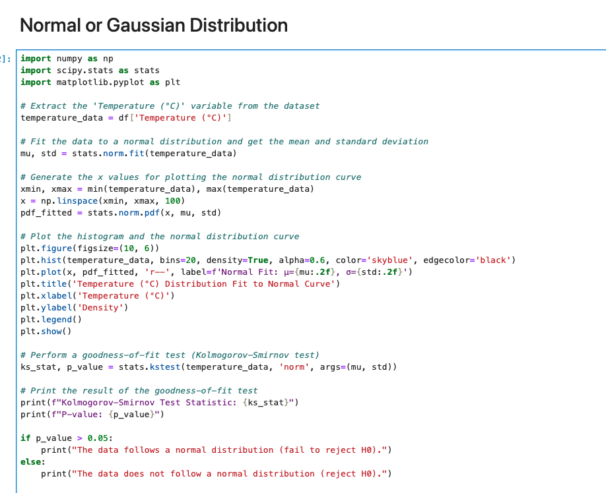
Normal or Gaussian Distribution

Slide 26
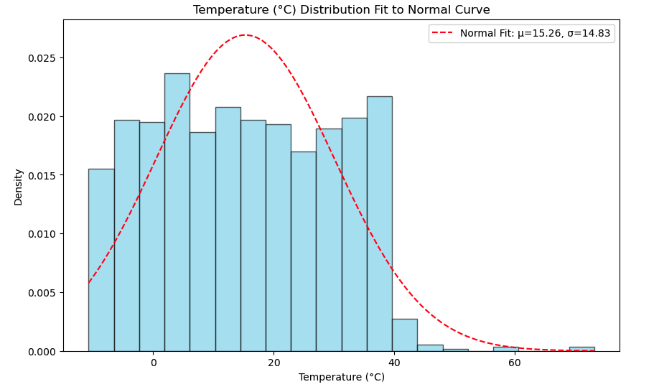
Normal or Gaussian Distribution (contd..)

Slide 27
Normal or Gaussian Distribution (contd..)
Shape Comparison: The histogram bars do not closely follow the normal curve, indicating that the Temperature (°C) data does not perfectly match a normal distribution. The data is more uniformly spread across a range, especially at lower temperature values, rather than peaking near the mean.
Mean and Standard Deviation: The red dashed line represents a normal distribution fit with a mean (μ) of 15.26 and a standard deviation (σ) of 14.83. These values describe the center and spread of the fitted normal distribution but do not capture the actual distribution well.
Skewness: The histogram shows a slightly left-skewed distribution with a more gradual decline as temperatures increase, suggesting a departure from normality. Some higher temperatures are less frequent, contributing to the longer right tail.
Implications for Analysis: Since the Temperature (°C) data does not align well with a normal distribution, using normal-based statistical methods might not be ideal. Further analysis could explore other distributions that might better fit this data.

Slide 28
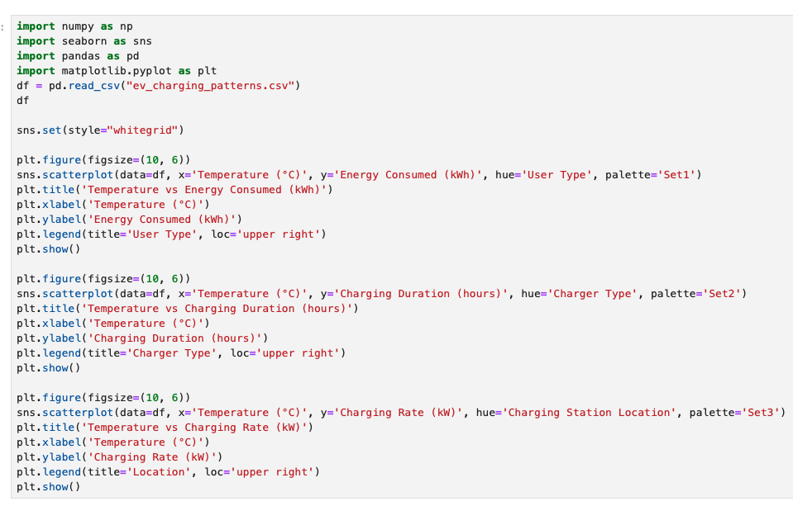
Scatter Plots (contd..)

Slide 29
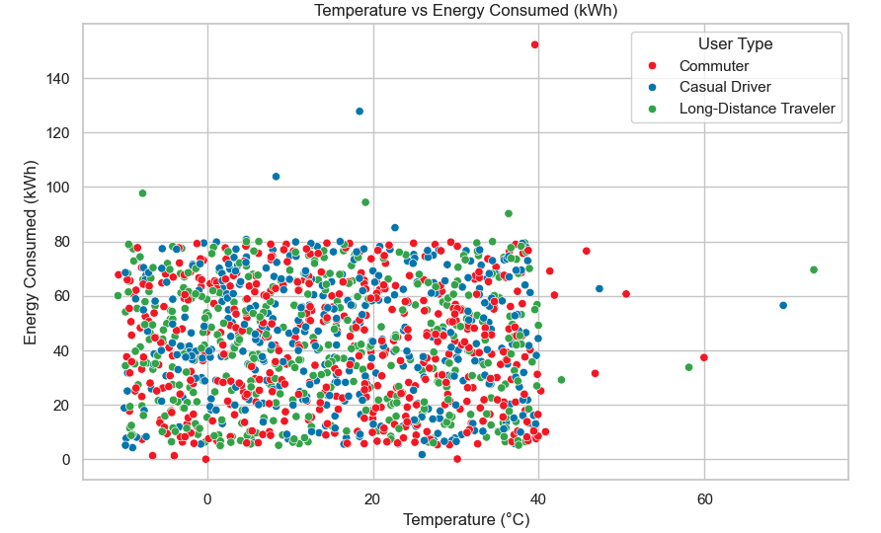
Scatter Plots (contd..)

Slide 30
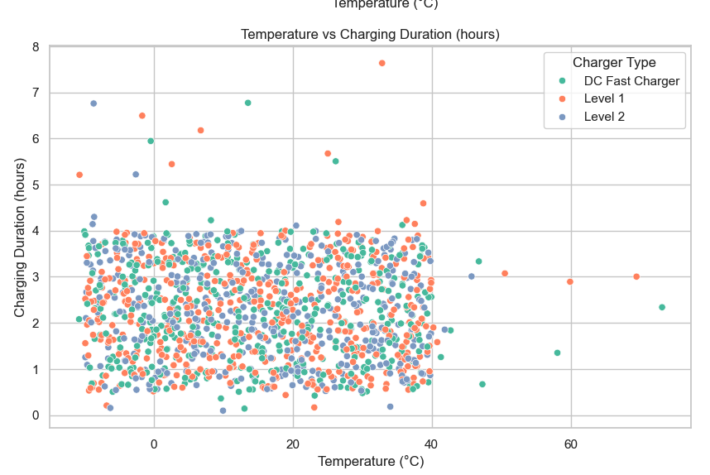
Scatter Plots (contd..)

Slide 31
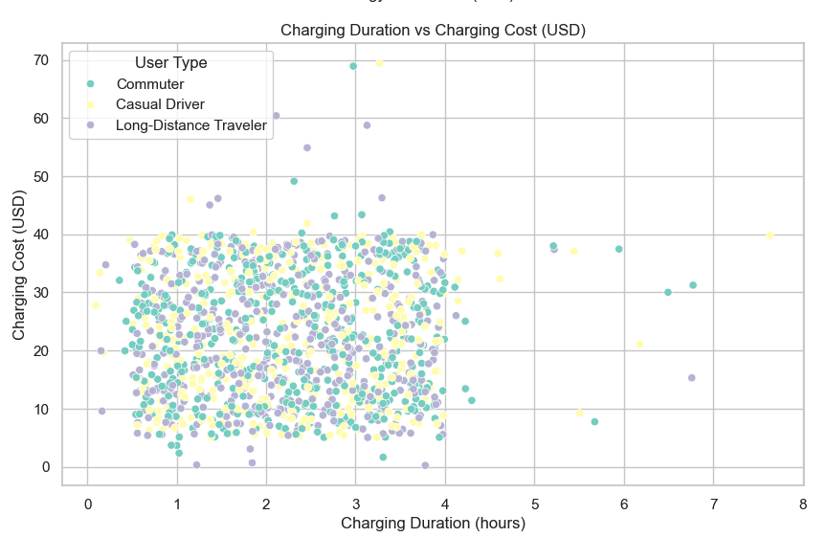
Scatter Plots (contd.)

Slide 32
Observation from the Scatter Plots
1. Data Points Distribution:
Most data points are concentrated between 0°C and 40°C regarding temperature and energy consumption from 0 kWh to 80 kWh.
There are a few outliers, particularly for energy consumed above 100 kWh and higher temperatures (above 40°C).
2. Energy Consumption Across User Types:
Commuters(red points) and Casual Drivers (blue points) dominate the lower to mid-range energy consumption (0-80 kWh).
Long-distance travelers (green points) appear scattered throughout the range, including high-energy consumption points beyond 80 kWh, suggesting they may consume more energy overall.
3. Temperature Impact:
A strong, visible relationship between temperature and energy consumption doesn’t exist. The points are spread relatively evenly across different temperature ranges, implying that energy consumption might not directly depend on temperature.
4. Outliers:
Some notable outliers exist where temperatures exceed 40°C, and there are also higher energy consumption points above 100 kWh, though they seem less common.

Slide 33
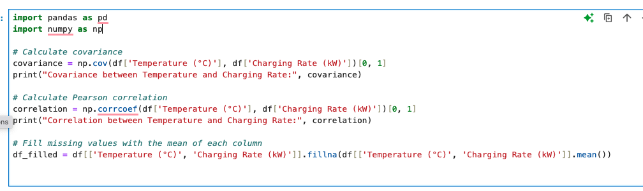
Covariance & Correlation

Slide 34
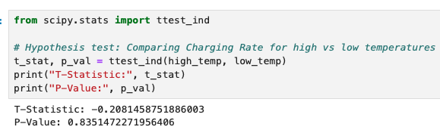
Hypothesis Testing

Slide 35
Hypothesis Testing
P-Value (0.835): The p-value is much higher than the common significance levels (e.g., 0.05 or 0.01), so we fail to reject the null hypothesis. In other words, there's no statistically significant difference between the charging rates for high and low temperatures. This suggests that, based on this data, temperature might not significantly impact the charging rate.
T-Statistic (-0.208): The t-statistic here is very close to zero, reinforcing the result that there’s little difference between the means of the two groups (high vs. low temperatures).
Conclusion: Since the p-value is large, the results suggest that any observed difference in charging rate between high and low temperatures is likely due to chance rather than a true effect of temperature. Based on this analysis, temperature does not appear to influence the charging rate significantly.

Slide 36
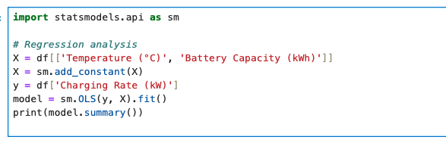
Regression Analysis

Slide 37
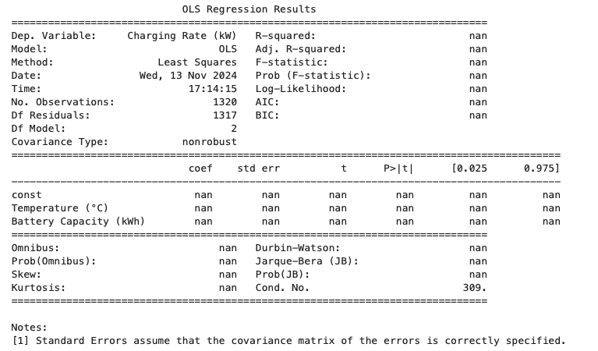
Output:

Slide 38
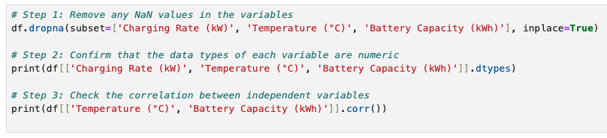
Regression Analysis (contd..)

Slide 39
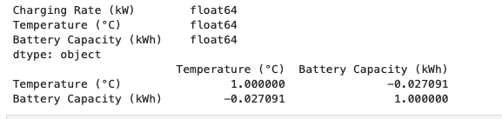
Output:

Slide 40
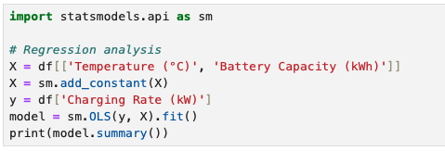
Regression Analysis (contd..)

Slide 41
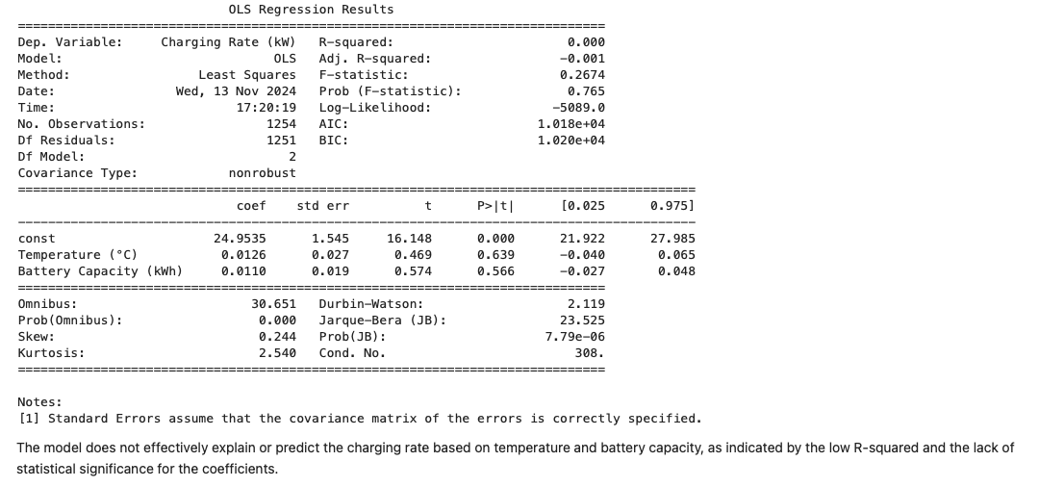
Output:

